Slide 1


ENM5320 – Integrating AI into Scientific Computing
Nat Trask
PIMI lab
University of Pennsylvania

Slide 2
Class philosophy
Philosophy
Develop AI-driven models for multiscale/multiphysics systems which preserve geometric structure in physics
Model acceleration
Learn a cheap low-dimensional problem trained to give the same answer as an expensive one to get real-time models
Model discovery
Governing physics are too complex to derive by pencil and paper, so use experiment instead
(multiscale, multiphysics, physics-agnostic problems)

Slide 3
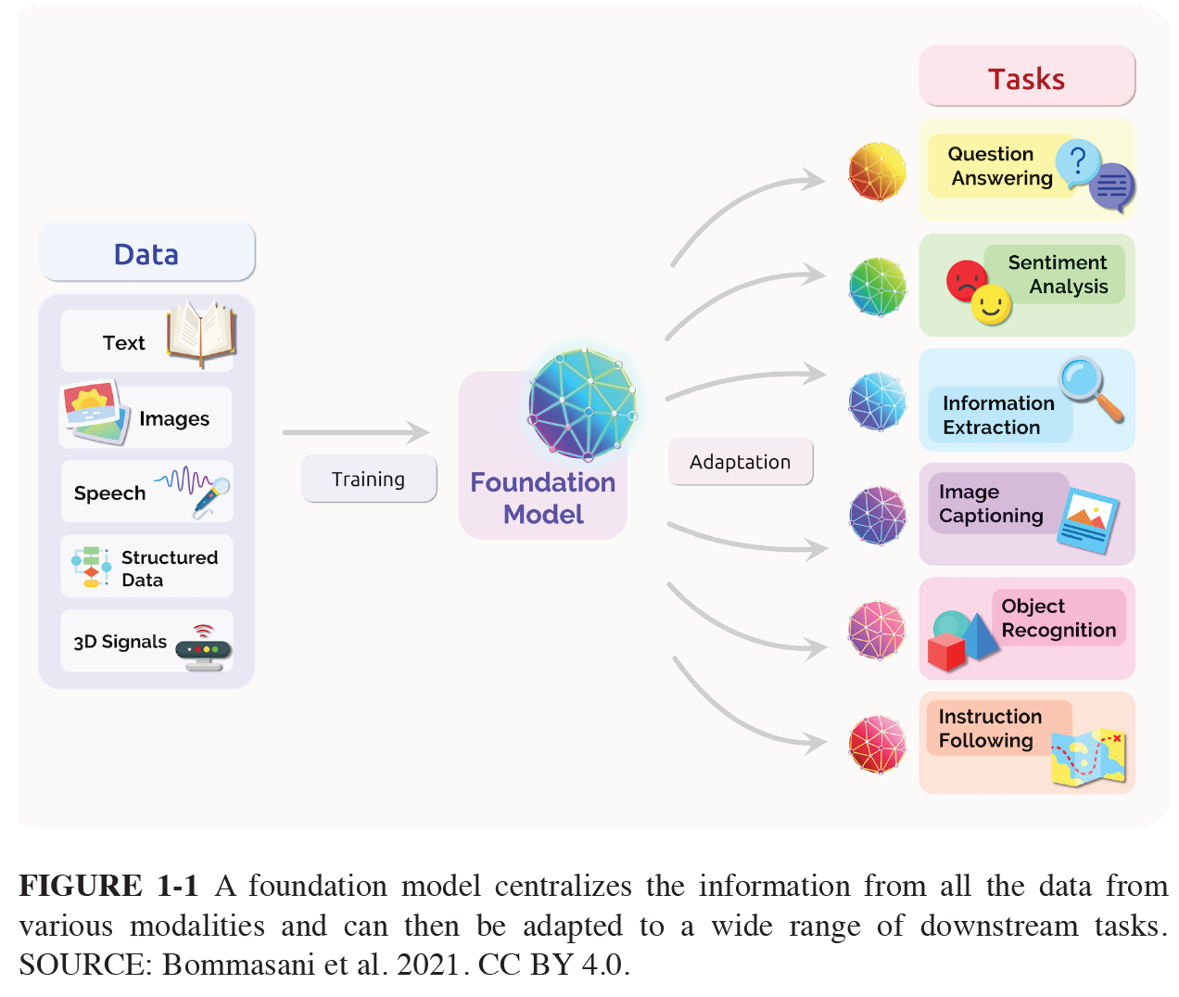
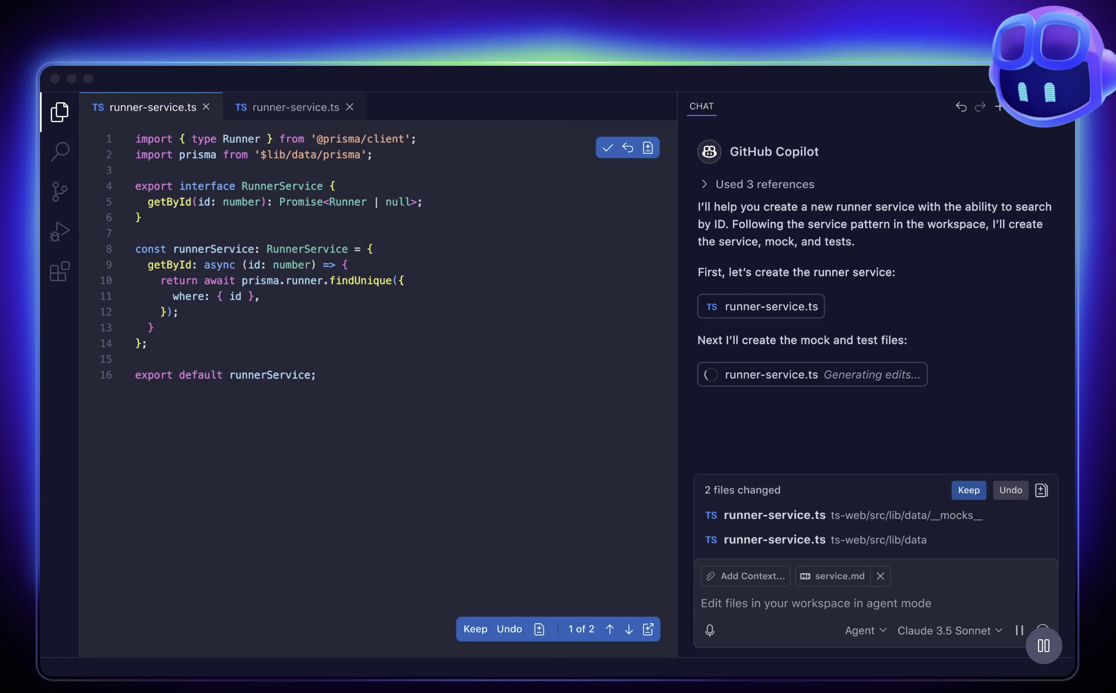
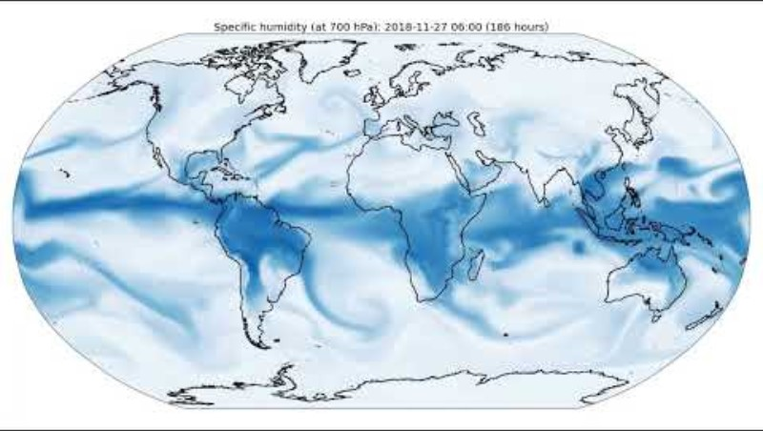
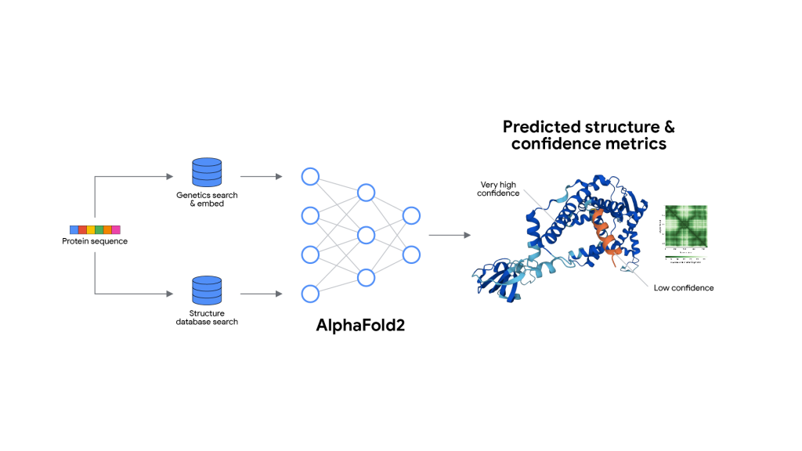


What do people have in mind when they describe a “foundation model for science”

Slide 4


Slide 5
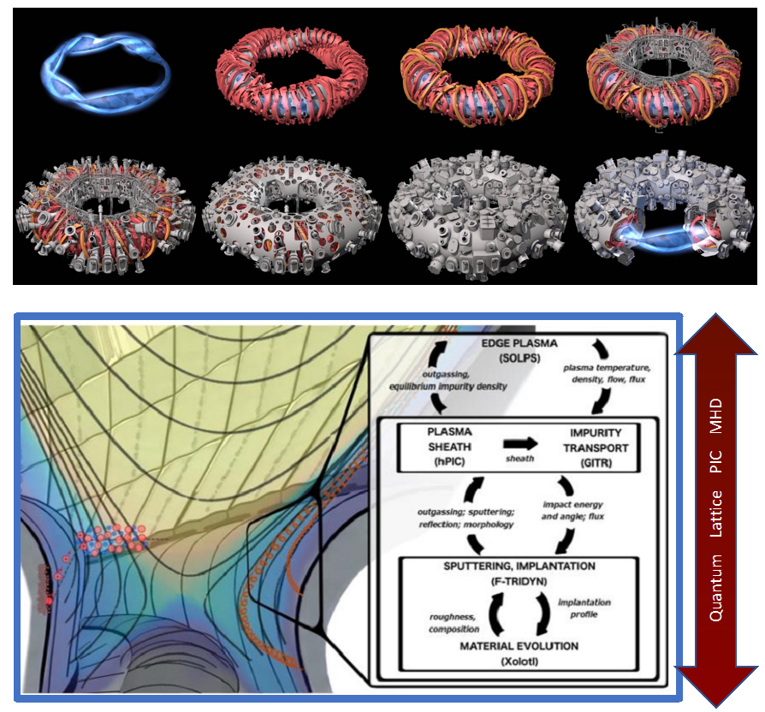
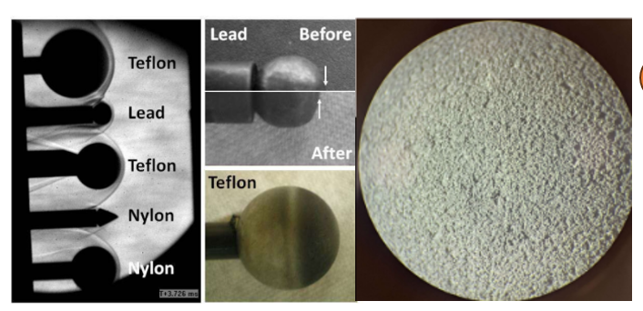
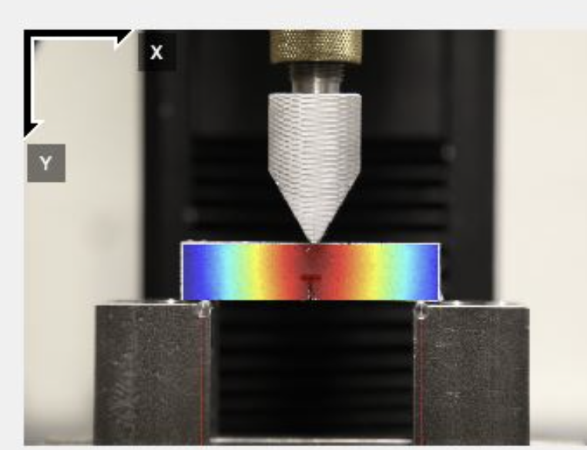
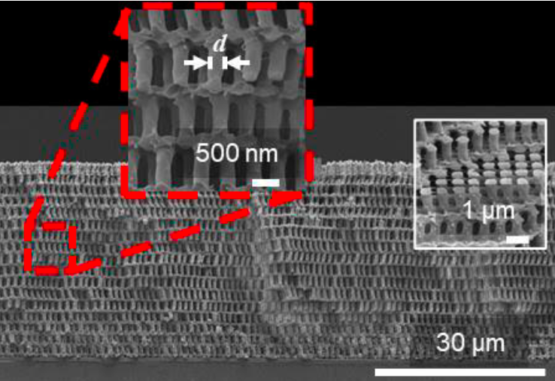
Some applications where structure preservation is important
Fusion reactor optimization
Commercialization of complex geometry reactor designs
Need exact handoff of conserved fluxes, Hugoniot relations,
Gauge symmetries
Hypersonic metamaterial design
Treat non-equilibrium physics in multiscale extreme physics processes
Need exact mass transfer, non-equilibrium chemistry, fluctuation/dissipation balance
Data-driven fracture
Homogenized mechanics for multiscale materials from experimental DIC
Exactly balance strain, Griffiths fracture energy for rare events conditioned on mesoscale geometry

Slide 6
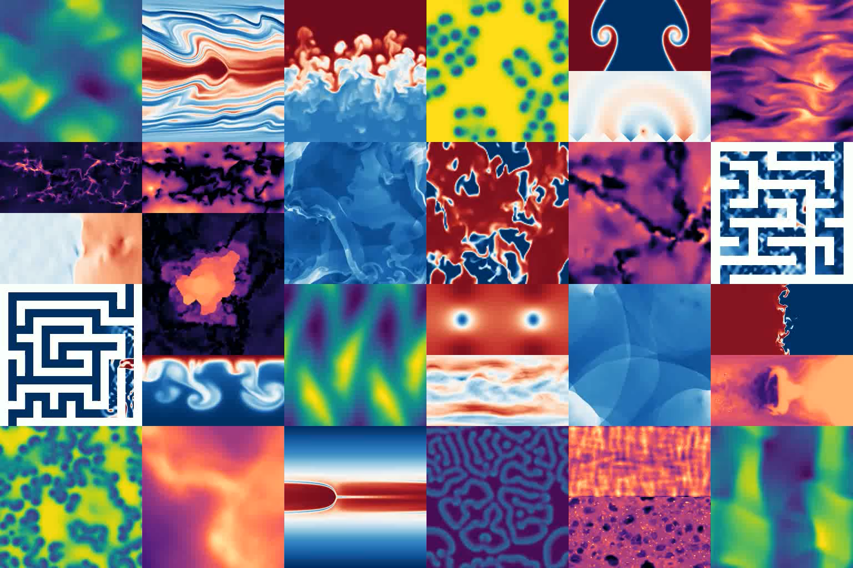
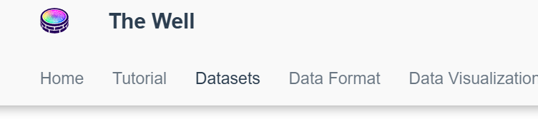
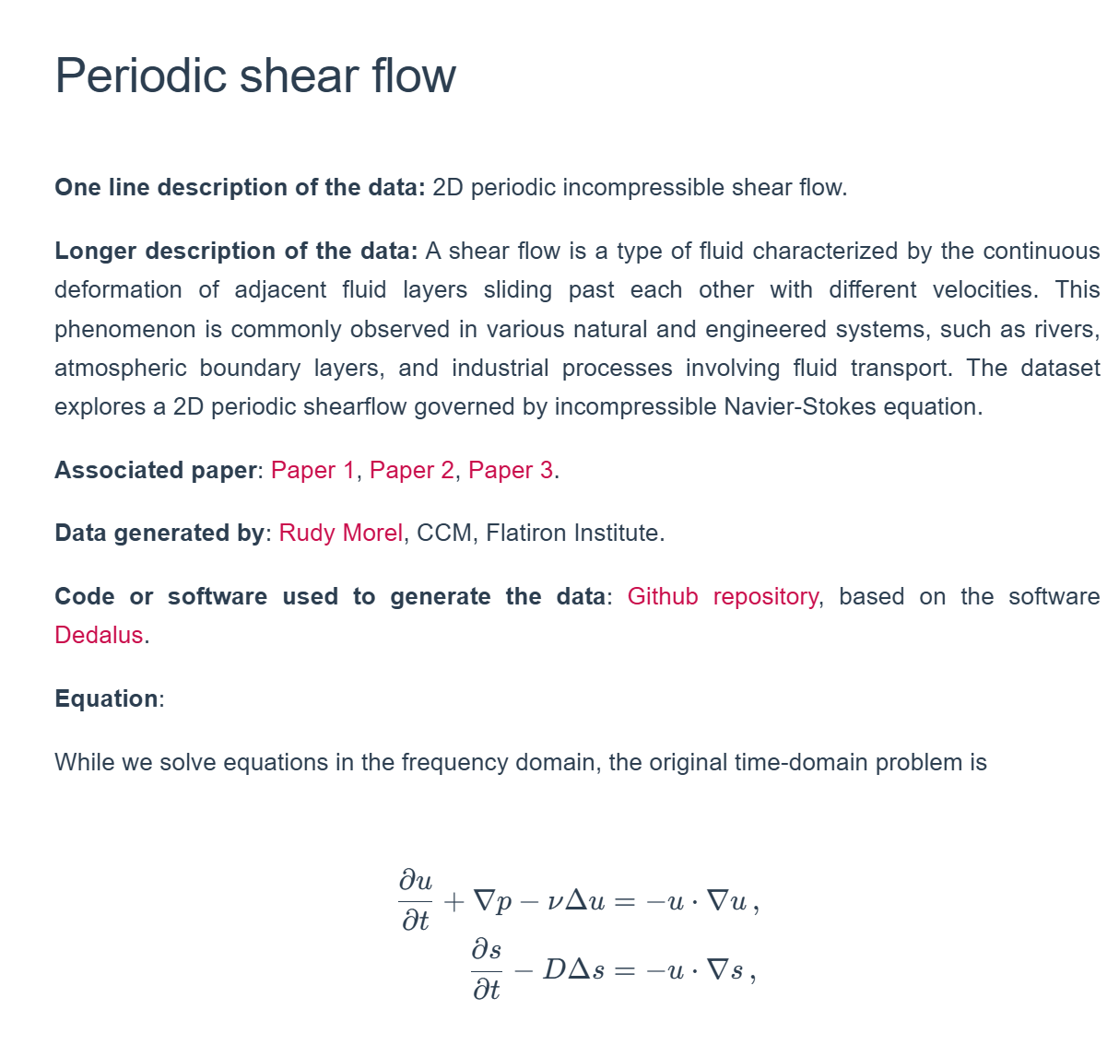

The debate happening right now – Do we need physics? Is scale enough? Can we access scale?

Slide 7
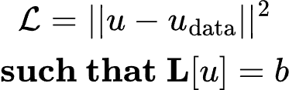
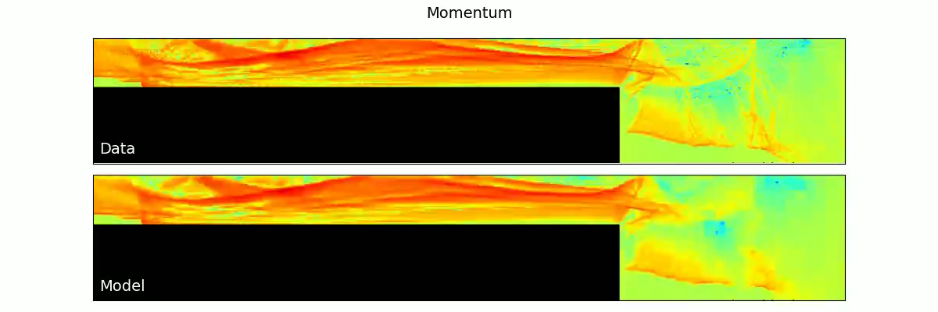
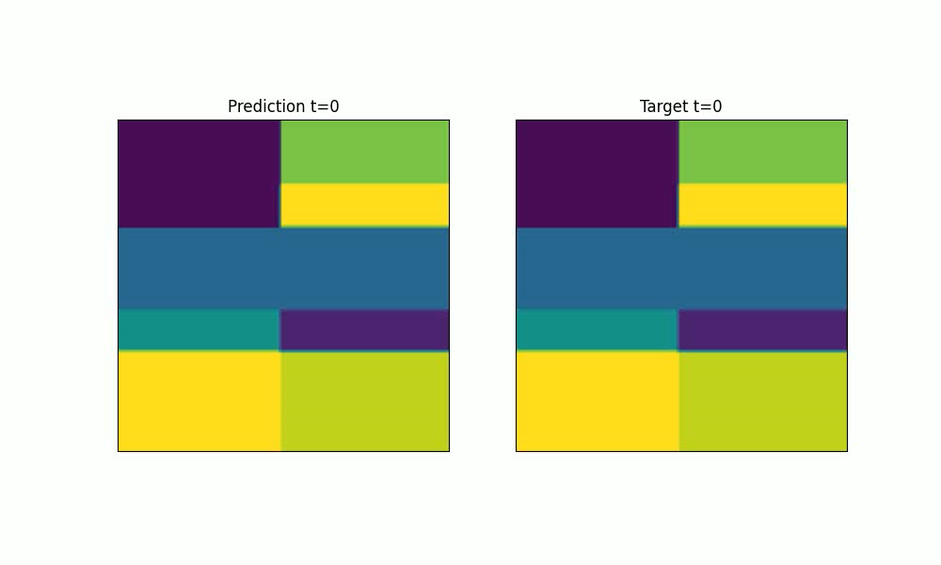
Operator regression vs data-driven physics

Slide 8
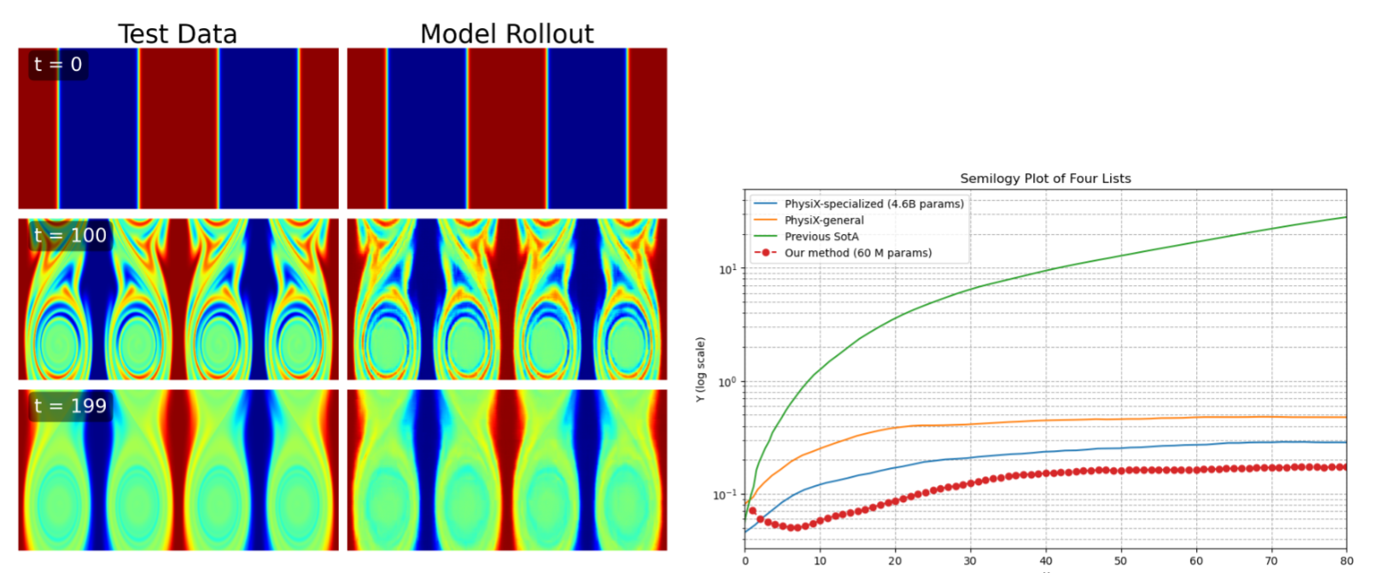
Hybrid FEM outperforms state of the art transformers
SotA with less parameters
FNOs fail (green)
Current SotA is a massive foundation model trained on all of Youtube
~100x less params
VMSE
Rollout time

Slide 9


Slide 10
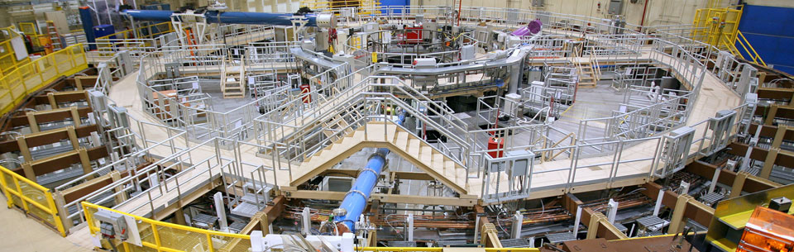
Black-box physics don’t work for serious problems
Metal
Source of leeched electrons
V+
Vacuum
Pulling electrons via capacitance
Magnetic Field
Driving harvested electron dynamics
Metal
Source of leeched electrons
V-
Electron Collector
To bombard downstream target

Slide 11
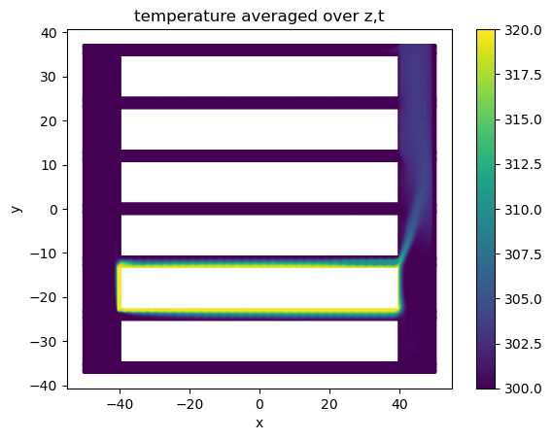
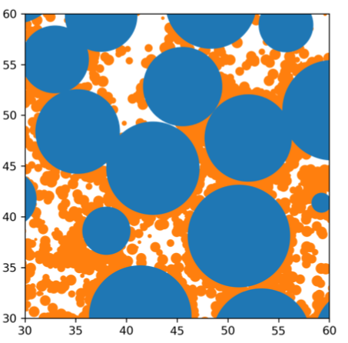
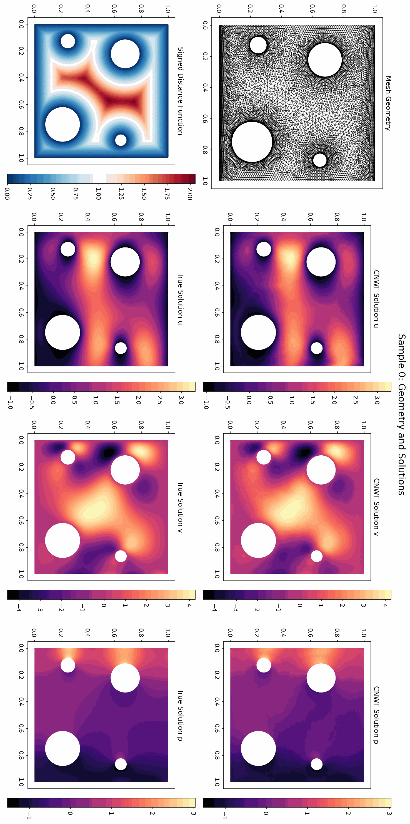
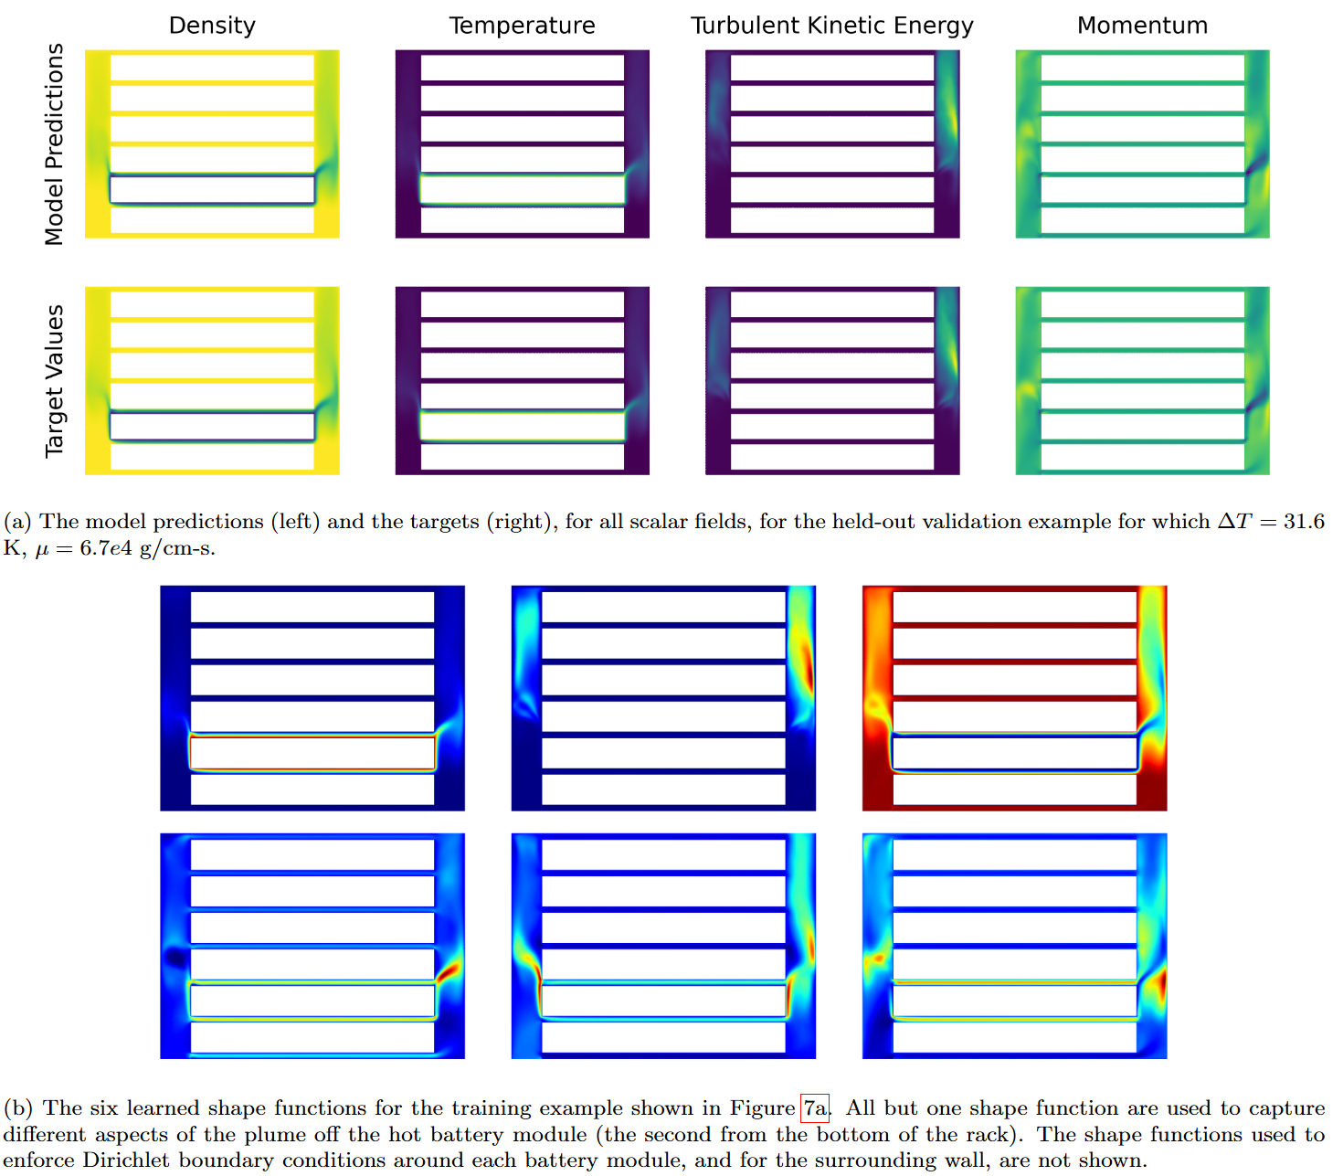
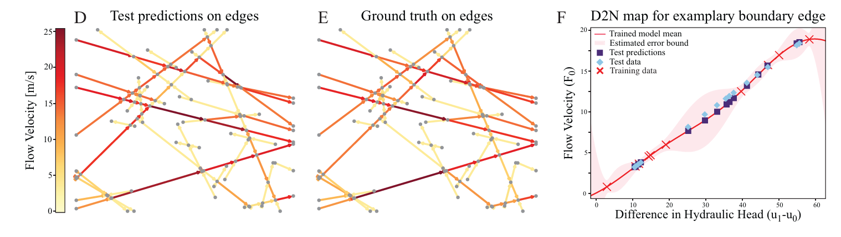
What kind of things can we build with these tools
Digital Twins for Systems of Systems
Foundation models for Geometry Exploration
Uncertainty quantification for predicted quantities
46
Notes:
Condition on geometry in a discretization invariant manner

Slide 12
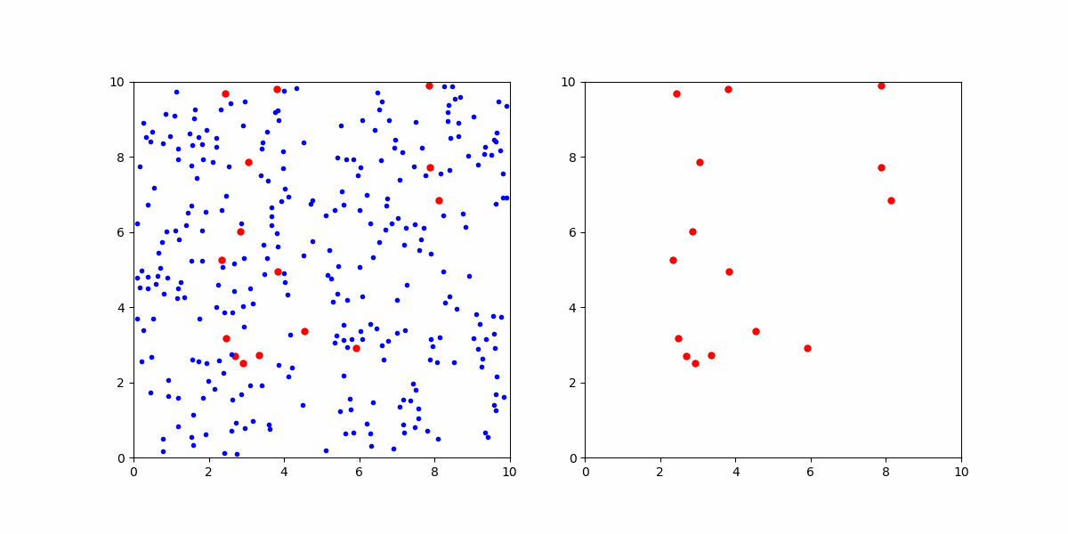
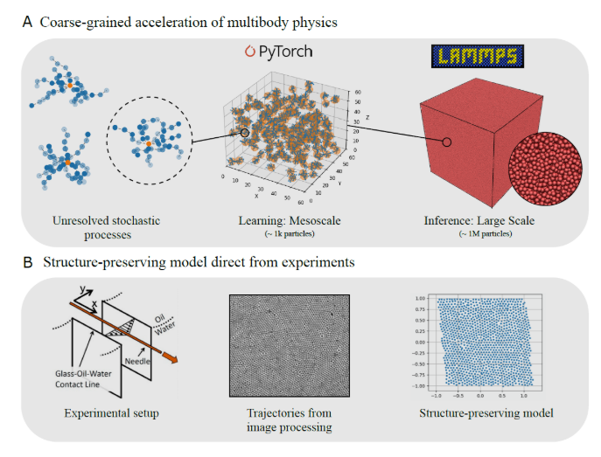
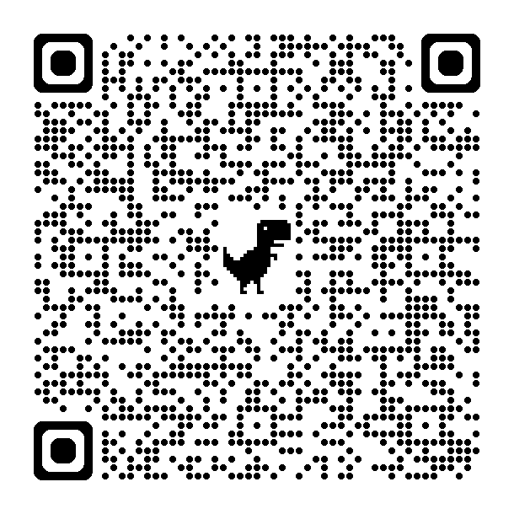
Emergent stochastic physics from coarse-grained dynamics
Mesoscale (mm+)
Emergent stochastic physics
Coarse-graining length-scale
(micron)
Unresolved physical processes
Microscale
(submicron)

Slide 13
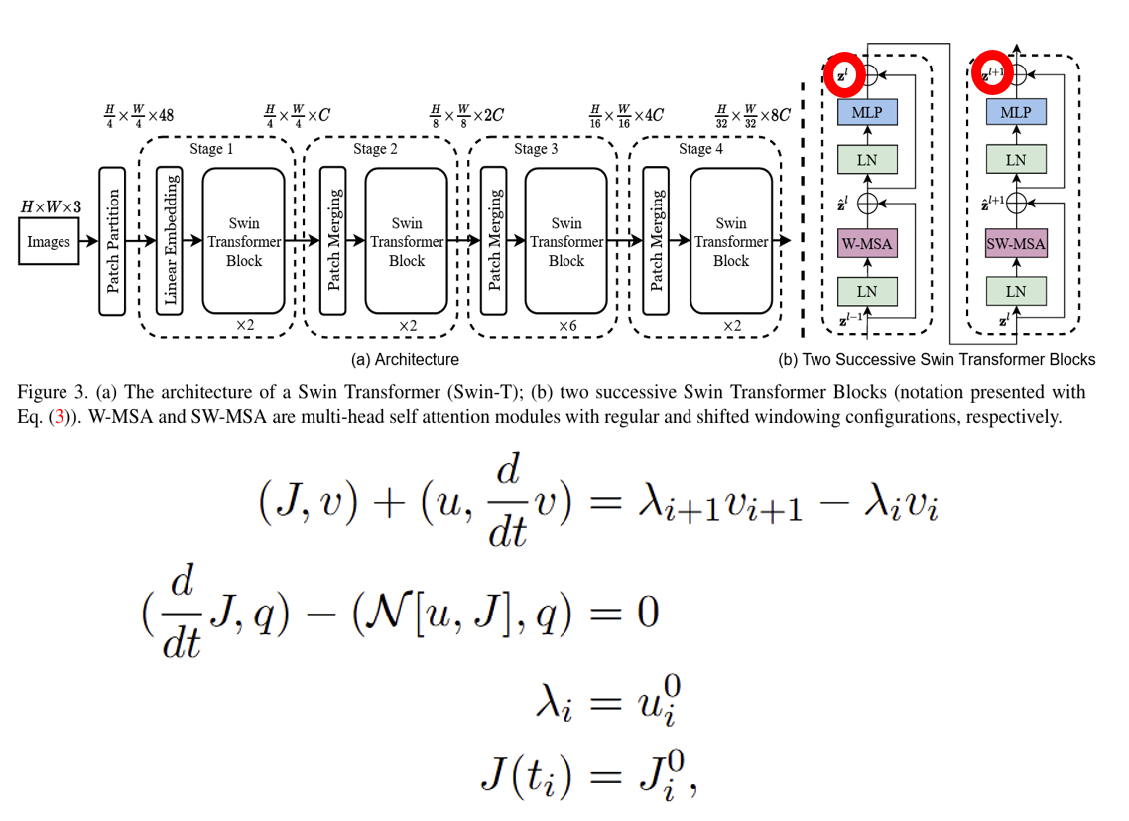
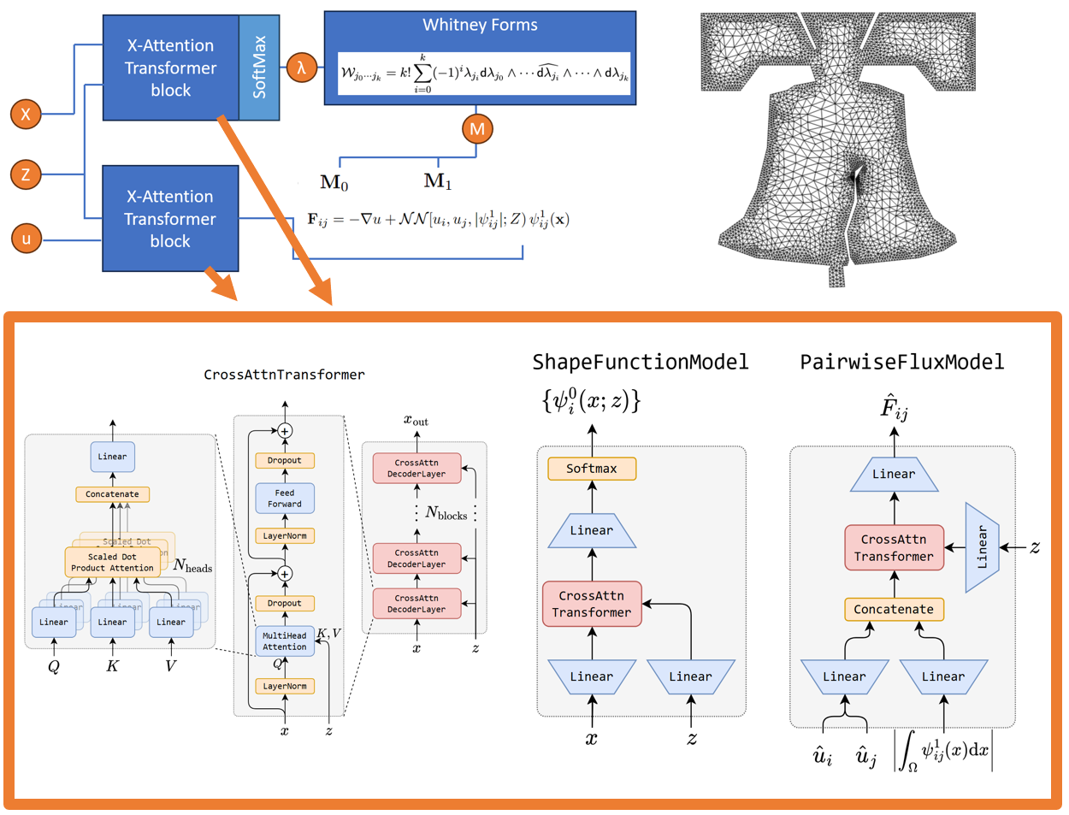
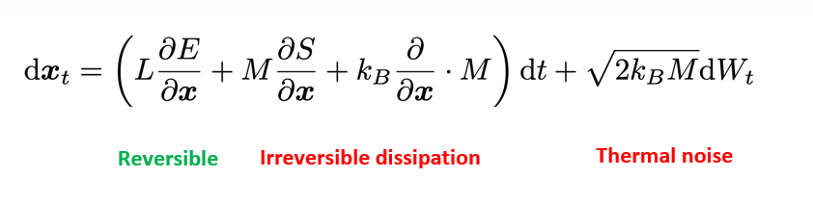
Tools you will obtain by the end of the class
Design geometric structure into learning architectures
Topological ideas (graphs)
Advanced FEM
Bracket-based dynamics
Integration with transformers

Slide 14
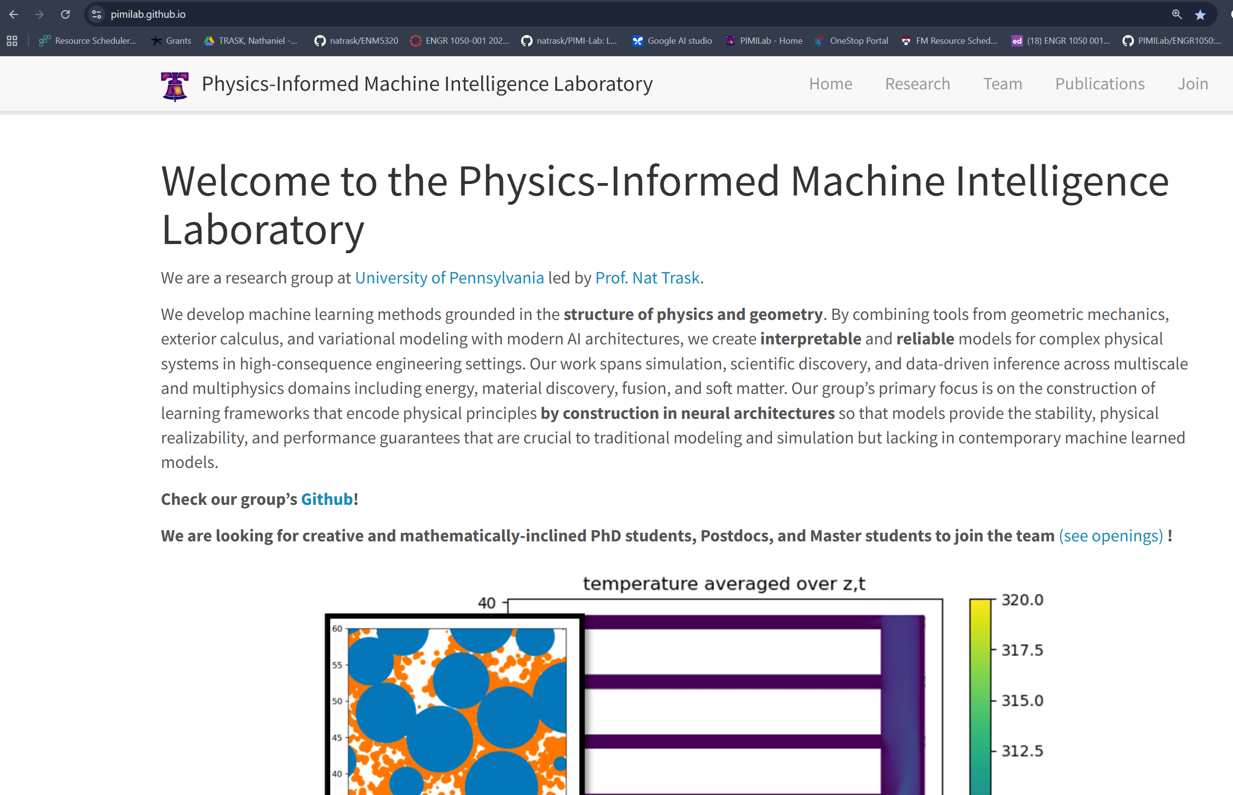
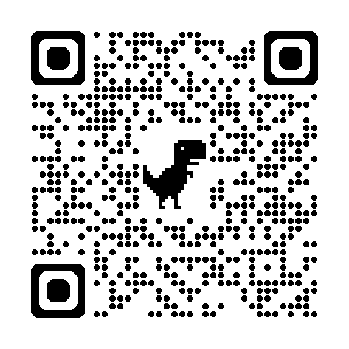
Reach out! Seeking:
Mathematically mature
Creative
Ambitious
new students

